Slide 1
Johnson County Community College Accelerated, Collaborative Technical Training Services (ACTTS)
HIMSS Conference
October 17, 2017

Slide 2
ACTTS Grant Team Gretchen Sherk, Grant Program Director Cordell Black, Career Coach Kayla Harrity, Career Coach Mindi Schwartz, Data Analyst Debbie Herrig, Administrative Assistant
Phone: 913-469-8500 Ext. 3453
Web Address: http://www.jccc.edu/admissions/apply/selective-admissions/actts-apply.html

Slide 3
ACTTS brief history
October, 2014 – TAACCCT (Trade Adjustment Assistance Community College and Career Training) grant awarded to JCCC
February, 2015 – Program director in place
June, 2015 - Remaining staff – Career Coaches, Data, and Admin Assistant in place
September, 2015 – grant’s first services provided to students
October, 2017 – Year 4 of the grant
March, 2018 – grant services to students end; services continued through May via JCCC support
April, 2018 – September, 2018 – Grant evaluation
September, 2018 – grant sunsets

Slide 4
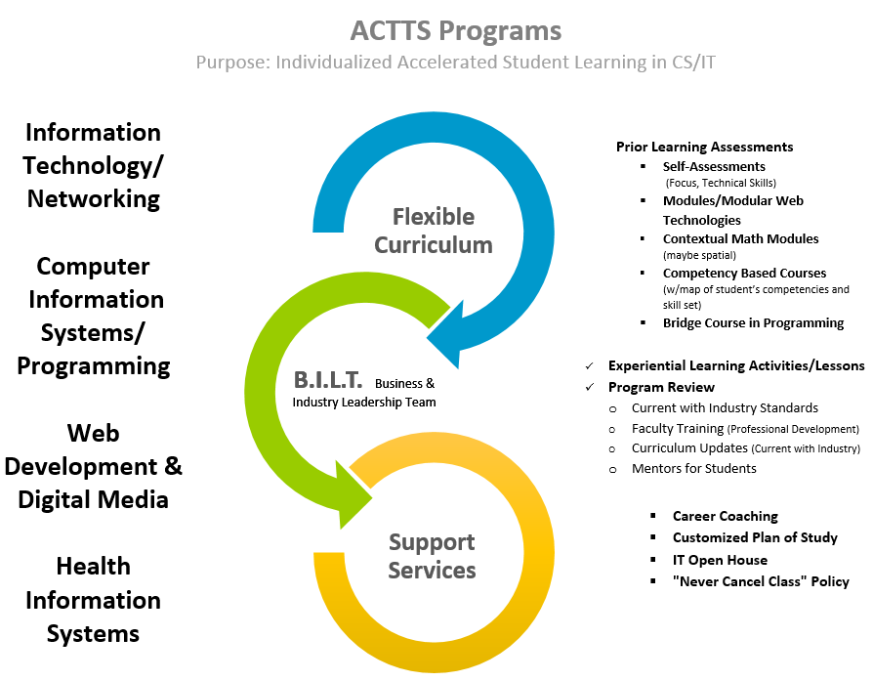

Slide 6
Chanel Maddox
“I am a May 2016 graduate of Johnson County Community College. I completed the Health Information Systems Implementation and Support Specialist Certificate program…I have accomplished more than I had imagined in the span of 6 months. I must attest to the amount of support, encouragement, and endless possibilities that Johnson County Community College offers…I am constantly challenged to think big, reach high, and to never give up. My wonderful Career Coach, Linda Dubar, my professors, and staff have guided me and made resources available to enhance my success.”

Slide 7
Thank you!!
Questions???
Phone: 913-469-8500 Ext. 3453
Web Address: http://www.jccc.edu/admissions/apply/selective-admissions/actts-apply.html

