Slide 1
Creative Ways to Attract and Retain the Best IT Talent
Presented by Ria Moss
October 19, 2016

Slide 2
AGENDA
Recruitment and Selection Process
Workforce and Succession Planning
Adopting a “New IT” workforce Mindset
Retention and Engagement Best Practices
Extrinsic and Intrinsic Incentive Rewards
What Motivates Passive, Fully Engaged Employees
Creating Career Ladders/Paths
Building Talent Pipelines

Slide 3
Did You Know?
Posting and praying recruiting strategies no longer work
Average number of applications a recruiter receives for a given job posting increased by 167%.
100-300 names to produce one hire for a key position
880 online visitors to yield one hire
Quality of many applicant pools is poor (35% of the typical applicant pool does not meet even the most basic job requirements)
Success comes from multi-source posting and proactive outreach
Propriety talent networks, aggregator sites, organization sites, referrals
Passive candidates are more open to a conversation
25% of the workforce is actively looking for a new opportunity
85% of the workforce is “I’m happy with my job and not looking for another, but would be open to other opportunities.”

Slide 4
Recruitment & Selection Process

Slide 5
Recruitment & Selection Process

Slide 6
Recruitment & Selection Process

Slide 7
Workforce & Succession Planning
1. Strategic Plan Leads the Way
2. Know What Talent You Need
3. Know What Talent You Have
4. Do The Work – Succession & Development Strategies
5. Recruit To Fill The Talent Gaps
6. Monitor, Evaluate, Improve
Retirements - next 5 yrs.
Talent for new strategies
Anticipated turnover
Proactive Sourcing
Talent Pipelining
Create & Execute Development Plans
Communicate

Slide 8
Adopting a “New IT” Workforce Mindset
Create a workforce plan to reskill, attract and source talent that will match the digital demands of the business and IT, including the use of analytics, mobility, cloud and other emerging technologies.
Assess how the IT organization’s skills and talent are being acquired, developed and managed on an ongoing basis.
IT organizations need to evaluate the skills for both their aging workforce and newer millennials and adjust training and development methods accordingly.

Slide 9
Retention and Engagement Best Practices How do you create the culture where employees develop ability, give discretionary effort (engage) and aspire for more?
Vision
Voice
More/Better Work
Training & Development
Recognition
Flexibility
Community at Work

Slide 10
Extrinsic and Intrinsic Incentive Rewards
Extrinsic Rewards
Originates from outside the individual
Intrinsic Rewards
Originates from inside the individual

Slide 11
Intrinsic Rewards
Challenge
Curiosity
Recognition
People are more motivated when they pursue goals that have personal meaning, that relate to their self-esteem, when performance feedback is available, and when attaining the goal is possible but not necessarily certain.
Internal motivation is increased when something in the physical environment grabs the individual’s attention (sensory curiosity) and when something about the activity stimulates the person to want to learn more (cognitive curiosity).
Control
People want control over themselves and their environments and want to determine what they pursue.
Cooperation & Competition
Intrinsic motivation can be increased in situations where people gain satisfaction from helping others and also in cases where they are able to compare their own performance favorably to that of others.
People enjoy having their accomplishment recognized by others, which can increase internal motivation.
Notes:
Factors increasing intrinsic motivation

Slide 12
Finding, Attracting and Hiring Talent What Motivates Passive, Fully Engaged Employees?

Slide 13
Creating Career Ladders/Paths
Career paths encompass varied forms of career progression, including the traditional vertical career ladders, dual career ladders, horizontal career lattices, career progression outside the organization and encore careers.
Career ladders are the progression of jobs in an organization’s specific occupational fields ranked from highest to lowest based on level of responsibility and pay.

Slide 14
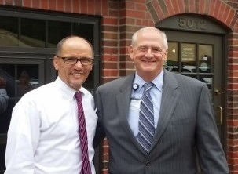
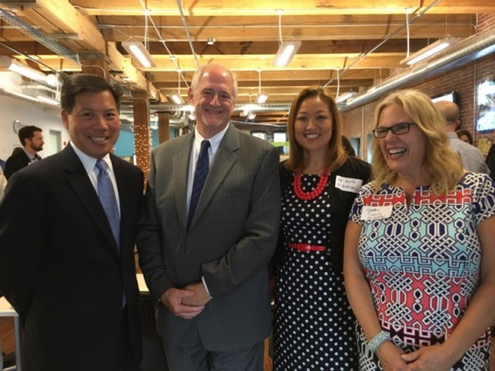
Building a Talent Pipeline
Developed a relationship with MO FEC and in producing a pipeline of IT talents
Generated over $200,000 in participating in their internship program
Hired eight interns from the internship program
We were mentioned in the White House announcement and KC Star article and Business Journal regarding to our participation in the Kansas City Full Employment Council Tech Hire grant
The success stories that we have accomplished through our internship program (Bruce Ives)
Visits from the Secretary of Labor, Thomas Perez and Deputy Secretary of Department of Labor, Chris Lu

