Slide 1
Clinical Informatics at Shawnee Mission Health
Andrea Hall

Slide 2
About Us
Shawnee Mission Medical Center (SMMC) is a 504-bed facility in a suburb of Kansas City
20,000 inpatient admissions annually
200,000 outpatient admissions annually
2,900 associates including 1100+ nurses
700 physicians representing 50 medical specialties
More births than any facility in Metropolitan KC, 2nd in the state of Kansas
Over 5,000 births in 2015

Slide 3
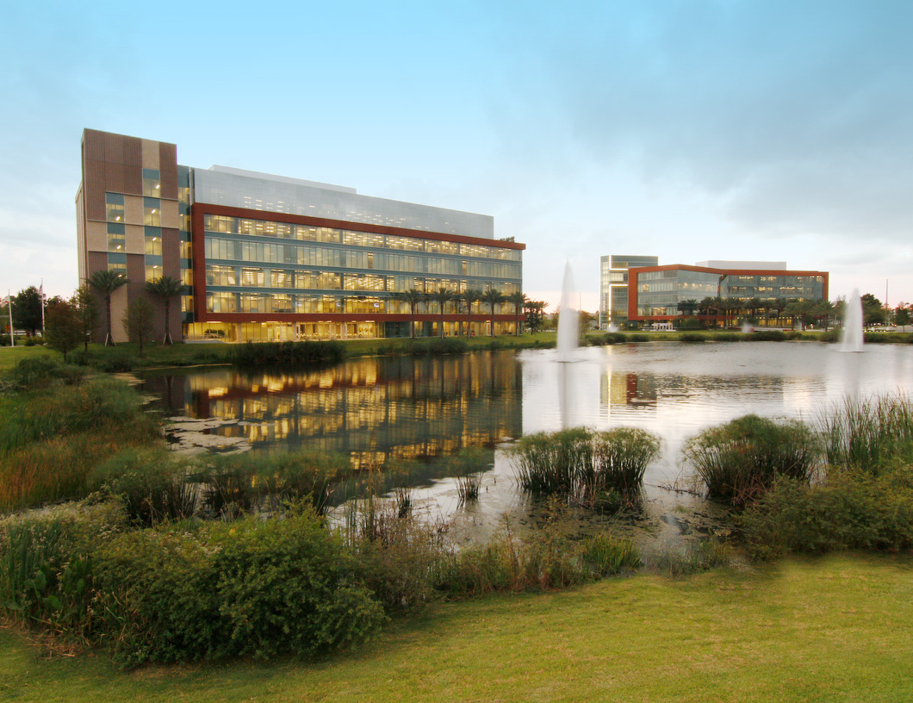
1973
Adventist Health System was established
46
Hospital campuses operated in 10 states
78,000
Employees and physicians
4.7 million+
Patients served annually
15
Skilled nursing facilities
22
Home health and hospice agencies
Notes:
Adventist Health System is a faith-based health care organization headquartered in Altamonte Springs, Florida. Shawnee Mission is only local hospital that is part of AHS. Our build and projects originate from our corporate offices. IS on the left.

Slide 4
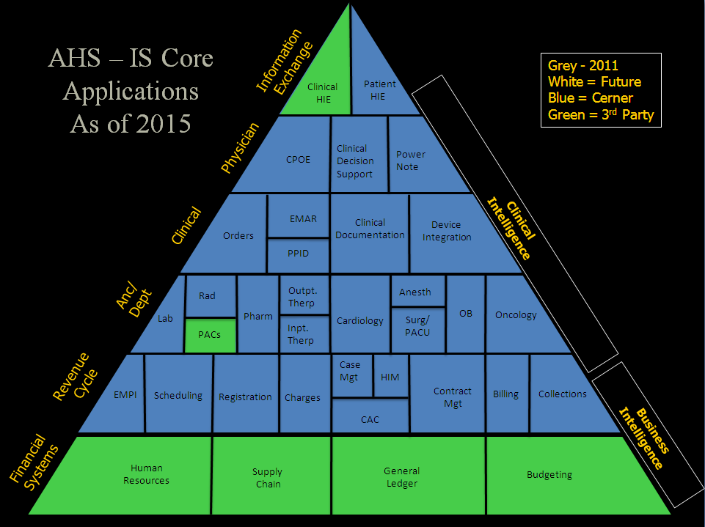
BLUE=CERNER
GREEN=3RD PARTY
Notes:
Having an integrated Cerner system has allowed us to pull data across disciplines. The blue indicates the Cerner solutions we have implemented. Patients are managed from scheduling through discharge and billing. Goal is a completely integrated system that saves time and resources and creates a seamless patient experience.

Slide 5
Where we started….
Computerized nurse charting in place since 2005
Informatics department was 2.5 physician liaisons, a part time nurse educator, a Surginet analyst and a Firstnet Analyst
In August of 2011, went live with Computerized Provider Order Entry (CPOE)
Notes:
Different training methods for different specialties. ER was trained with Powernote first and went live with powernote prior to CPOE. Triaining was done by hospital staff and providers. Was driven by task instead of workflow

Slide 6
CPOE Education Plan
Providers trained in classes by specialty
Information was generic and without complete workflow analysis
No real training for ancillary departments
Nurses were trained with ‘hard limits.’
Notes:
Classes were taught to providers by the providers.

Slide 7
CPOE go-live
Command center for a few weeks post go-live
Liaisons assigned to specific areas, and responded to concerns when called
Not everyone knew where to find help
Ancillary departments often unsure how to troubleshoot. Providers often made multiple calls to find answers
Notes:
Struggled with ‘hard limits’ by nursing. Very black and white. Providers spending a lot of time looking for answers

Slide 8
Negatively Impacted Areas
OB/GYN
Providers on staff at multiple hospitals
No competitor live with CPOE
Loss of SMMC specific plans
Groups left- moved deliveries
Surgery
Volume changes post CPOE
Again, some on staff other places
Challenges getting pre-admit/pre-op orders on patients
Cancelled cases
Notes:
OB bring a lot of volume to Shawnee Mission. During this time we were building an OB tower. Deliver more babies than any other in KC.

Slide 9
Realized our flaws…
Increase in size of informatics
Changed to all nursing staff
Focus change - physician customer service and satisfaction
Thorough workflow evaluations
Notes:
Keep them working, ticket escalation, workflow versus task, filtering education information, personality, Rounding. Visibility.

Slide 10
What we did for OB
Advocated for the key changes providers wanted to see in the order sets
Dedicated full-time liaison who was present at every OB related meeting
Visits to offices to assist providers in saving favorites
OB optimization project

Slide 11
What we did for surgery
Walked through the physician process with all surgery departments
Created guides for lounges with surgeon specific workflow
Daily presence in surgeon lounge
Engaging and supporting those physicians here infrequently

Slide 12
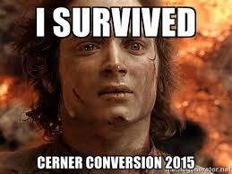
Results
1100 more births in 2013 than 2012
All OB’s came back, plus an additional group joined
Surgery volume slower to respond- but is back to pre-CPOE numbers

Slide 13
Where are we now?
Clinical Informatics Department with 8 members
4 physician liaisons
1 nurse educator
1 Surginet/Netlearning Analyst
1 Clinical Optimization Coordinator
Notes:
Those not listed - Report to CMO. Helps encourage physicians. Addition of RCMIO. AHS support. Clinics.

Slide 14
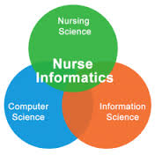
Who do we hire?
Strong clinicians
Good communicators
Passionate about change and pushing healthcare forward
Nurses with thick skin
Notes:
If you don’t like change, not for you. We can teach anyone the computer. Good people skills. People had been superusers, different skill sets.

Slide 15
Physician Liaison Responsibilities
Clear delineation of department support (including service lines)
Rounding every day by every member
Shadowing physicians looking for time-saving opportunities
Better prep for upgrades and changes to the system
Notes:
Follow-up, listening, not talking down to providers. Customization- powerplans, powernotes, favorites. What can we do to save them phone calls from ancillary departments. Seen as physician educators which is interesting dynamic as nurses. Filter information to the providers. Middle man to corporate, cerner, nursing. Place workflow and change requests

Slide 16
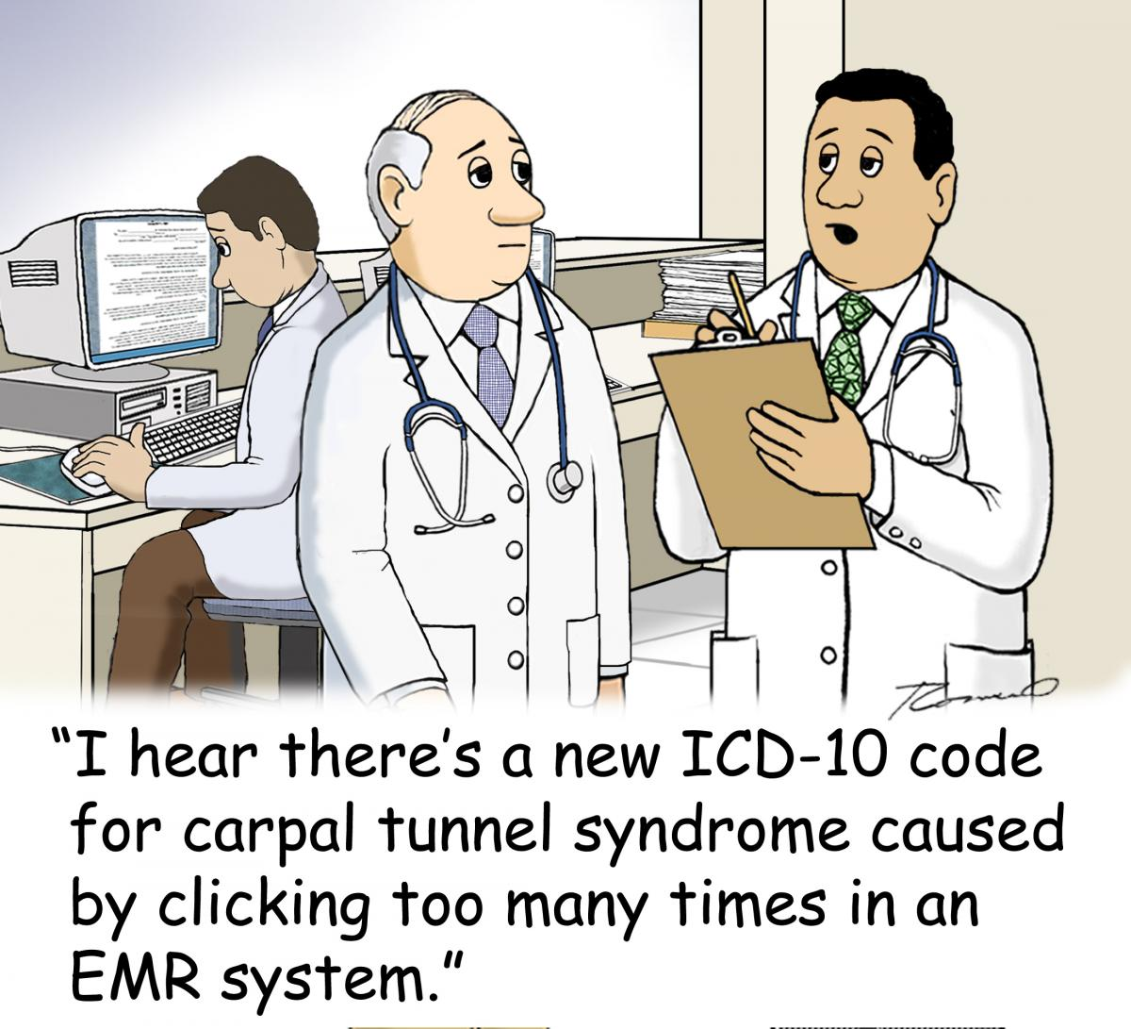

Slide 17
Physician Onboarding Process
Training with liaison assigned to their area
1:1 orientation designed around the provider and their specialty
Packet with orientation manual, tip sheets, gift
Meetings with ancillary departments (quality, UM, clinical documentation specialists
Follow up after training- shadow days

Slide 18
Nurse Educator
House nursing expert
Teaching orientation
Project management
Upgrade and project education
Rounding
Reports provided to managers and other leaders
Notes:
Nursing education is different as nurses are employed. Significant committee and resource work. TJC IPOC example

Slide 19
Informatics can help!
Everything is a computer issue!
Change catalysts
Workflow redesign
Project managers
Addressing problems and challenges
Constant regulatory changes
Notes:
TJC, HBIPS, CMS 2 midnight rule. Electronic tools and problem solving – readmission prevention, Bridgecare, heart failure clinic. Personalized solutions.

Slide 20
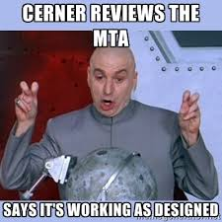
A day in the busy, caffeine fueled life of a nurse informaticist
Coffee. Email. Repeat.
Specimen scanning train the trainer session
Nurse Executive Council
Capacity Management relaunch meeting
PharmNet monthly meeting
Coffee again
Transportation technology options
Netlearning changes
Notes:
Variety of projects. Help desk tickets in between.

Slide 21
Nurse On-Boarding
Scenario based training
Consistent training across the house
Reference manual available in class and online
Modeled after physician onboarding (workflow focused)
1:1 follow up with new graduates

Slide 22
Chart Navigation class
Created a class for ancillary departments/staff who don’t document but need to find information in the chart
Provide them with a resource manual
Offered twice a year
Notes:
Answering multiple questions about charts. Departments calling without an idea of resolution. Researching incident reports correctly. Has been geared towards quality and medical records

Slide 23
Meaningful Use
Attested to Stage 2
Challenges with the two new core items- VDT of the patient portal and Electronic Summary of Care
Working with offices to include direct email in their office EMRs
Registration actively enrolling patients
Monthly updates to involved teams
Looking forward to Stage 3

Slide 24
Moving forward
Continued integration and leveraging of data
Personalized, evidence based medicine
Improving the patient experience
Improving the provider experience
Monitoring metrics
Leader training
Notes:
Portal, transparency, portability, information sharing, skylight. Optimizing the product.

Slide 25
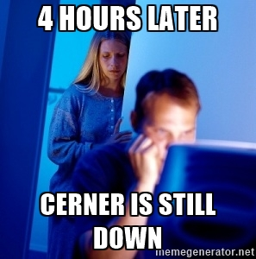
How do we know we are making a difference?
Provider feedback to administration
Physician order entry at 90%
Leapfrog grade A
Numbers and more numbers…
Notes:
Panic when the system is down! Medication scanning rates

Slide 26
How do informaticists find their ‘Why?’
Notes:
Blood bank scanning, population health, breast milk scanning, eQuality. Ease of data access.

Slide 27
Contact Information
Andrea Hall
Andrea.hall2@ahss.org 913-789-5577

